Slide 1
DOCUMENT REQUIREMENT FOR CODE OPENING
SR No | DEALER | ARS/GB
1 | GST CERTIFICATE | ADDRESS PROOF (LETTER HEAD/AADHAR CARD/ ANY GOVERNMENT ID)
2 | PAN CARD | PAN CARD
3 | BANK STATEMENT/BANK PASSBOOK COPY | BANK STATEMENT/BANK PASSBOOK COPY
4 | CANCEL CHEQUE | CANCEL CHEQUE
5 | SD BLANK CHEQUE (2 NOS) | FORM DULLY FILLED
6 | 194 Q DECLARATION | NO THIRD PARTY PAYMENT ALLOWED
7 | FORM DULLY FILLED | CORRECT RTGS DETAILS MENTION IN ON BOARDING
8 | NO THIRD PARTY PAYMENT ALLOWED | IN CASE OF LADY PROPRITOR AUTHORIZATION LETTER NEEDED
9 | CORRECT RTGS DETAILS MENTION IN ON BOARDING | IN ON BOARDING ALL DETAILS SHOULD BE FILLED
10 | IN CASE OF LADY PROPRITOR AUTHORIZATION LETTER NEEDED | ASSOCIATE DEALER NAME AND CODE SHOULD BE MENTION IN IN ON BOARDING
11 | IN ON BOARDING ALL DETAILS SHOULD BE FILLED

Slide 2
Dealer/ARS ON Boarding points
In ON boarding most of the users are not uploading relevant document and form scan copy while process the customer data.
Documents need to check like Dealer/ARS name should be same in all the document. Address should be matched with given document.
Bank proof should be Bank statement or Bank passbook which have Bank name and address of both bank as well as Customer. Cancel cheque should also be attach
ITR declaration should clearly be mentioned exceeded/not exceeded 10 cr.
While uploading form onboarding all required scanned copies which were being sent earlier, must be attached in given option “other document”

Slide 3
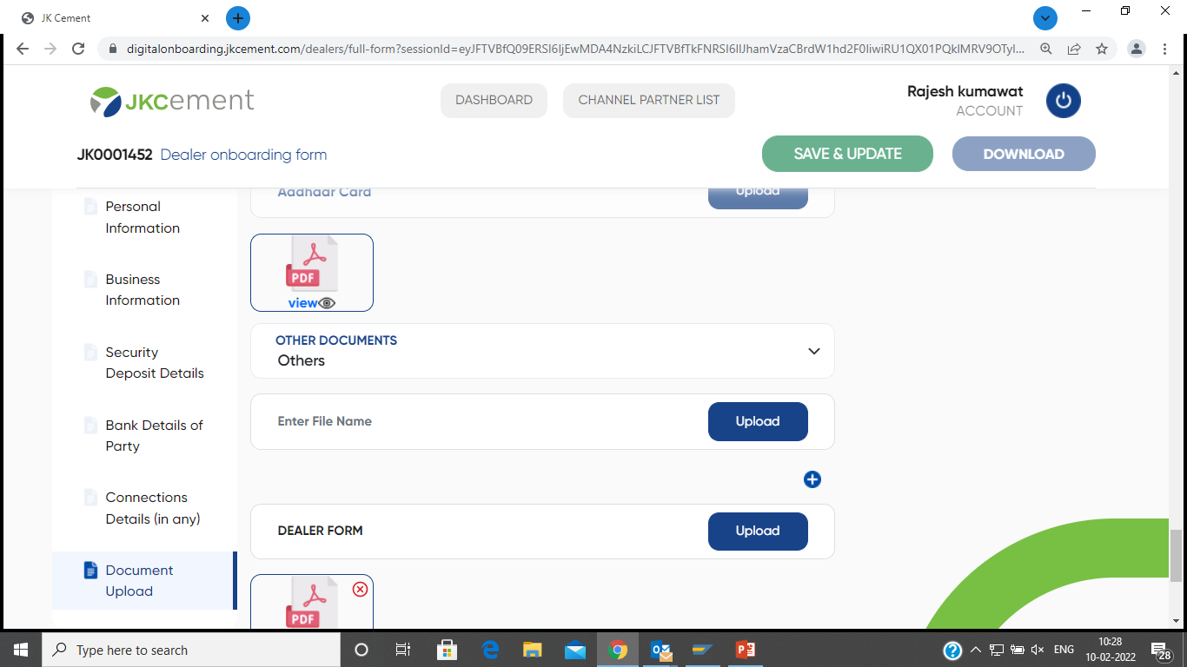

Slide 4
Pendency of Hard copy of the form
Hard copy of the form should be send same day after the code opening so that security can be updated on time.
All the relevant document should be attach with Form.
AREA OFFICE | DISTRICT | CUSTOMER GROUP | MONTH
 |  |  | Apr-22 | Jun-22 | Jul-22 | Aug-22 | TOTAL
AO-ALWAR | ALWAR | ARS | 1 | 1 |  |  | 2
 |  | STOCKIST |  |  | 1 |  | 1
 | BHARATPUR | ARS |  | 2 |  |  | 2
 | DHOLPUR | ARS |  |  | 2 |  | 2
AO-JAIPUR RURAL | DAUSA | ARS |  |  | 2 |  | 2
 |  | STOCKIST |  |  | 1 |  | 1
AO-JAIPUR URBAN | JAIPUR | ARS |  | 1 |  | 3 | 4
TOTAL |  |  | 1 | 4 | 6 | 3 | 14

Slide 5
BOC PENDENCY
As per guideline BOC should completed in a month. Like for June.22 BOC should completed till 31ST July.22
We have pendency of April.22 to June.22 BOC till date as per below
Area Office | District | April.22 | May.22 | June.22
AO-ALWAR | ALWAR | 24 | 21 | 59
 | BHARATPUR | 1 | 2 | 39
 | DHOLPUR | 2 | 1 | 15
AO-JAIPUR RURAL | DAUSA | 2 | 6 | 20
 | JAIPUR | 6 | 7 | 43
AO-JAIPUR URBAN | JAIPUR | 8 | 5 | 10
Grand Total |  | 43 | 42 | 186

Slide 6
REFUND RELATED DOCUMENTS REQUIREMENT
Sr No | DEALER | ARS/GB
1 | PARTY REQUEST LETTER | PARTY REQUEST LETTER
2 | BO LETTER | DEALER LETTER
3 | MONEY RECEIPT AND APPOINTMENT LETTER | MONEY RECEIPT AND APPOINTMENT LETTER
4 | PAN CARD COPY | PAN CARD COPY
5 | CANCEL CHEQUE FOR RTGS | CANCEL CHEQUE FOR RTGS
6 | AFFIDAVIT IN CASE OF MONEY RECEIPT AND APPOINTMENT MISSING | AFFIDAVIT IN CASE OF MONEY RECEIPT AND APPOINTMENT MISSING
7 | FORMAT DULY FILLED AND SIGNED FROM DMO/ASM/SH/ZH | FORMAT DULY FILLED AND SIGNED FROM DMO/ASM/SH/ZH

Slide 7
COMMISSION BILLS AND C&F BILLS REALTED GUIDELINE
BO/CS/SS COMISSION BILLS AND TARGET BILLS SHOULD REACH JAIPUR OFFICE TILL 3rd AFTER MONTH CLOSED, LIKE FOR JULY MONTH BILLS SHOULD REACH JAIPUR OFFICE 3rd OF AUG
C&F/TRANSPORTATION/CEMENT EXPRESS BILLS SHOULD ALSO REACH TILL 3rd AFTER MONTH CLOSED
CEMENT EXPRESS BILLS SHOULD BE CHECKED AND SIGNED FROM LOGISTIC DEPARTMENT AND ASM/SH/ZH

